Slide 1
Chapter 5
Working with Files and Directories
PHP Programming with MySQL
2nd Edition

Slide 2
Objectives
In this chapter, you will:
Understand file type and permissions
Work with directories
Upload and download files
Write data to files
Read data from files
Open and close a file stream
Manage files and directories
PHP Programming with MySQL, 2nd Edition

Slide 3
Understanding File Types and Permissions
File types affect how information is stored in files and retrieved from them
File permissions determine the actions that a specific user can and cannot perform on a file
PHP Programming with MySQL, 2nd Edition

Slide 4
Understanding File Types
A binary file is a series of characters or bytes for which PHP attaches no special meaning
  Structure is determined by the application that reads or writes to the file
A text file has only printable characters and a small set of control or formatting characters
  Text files translate the end-of-line character sequences such as \n or \r\n to carriage returns
PHP Programming with MySQL, 2nd Edition

Slide 5
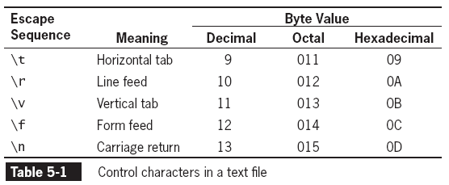
Understanding File Types
(continued)
PHP Programming with MySQL, 2nd Edition

Slide 6
Understanding File Types
(continued)
Different operating systems use different escape sequences to identify the end of a line:
  Use the \n sequence to end a line on a UNIX/Linux operating system
  Use the \n\r sequence to end a line on a Windows operating system
  Use the \r sequence to end a line on a Macintosh operating system.
PHP Programming with MySQL, 2nd Edition

Slide 7

Understanding File Types
(continued)
Scripts written in a UNIX/Linux text editor display differently when opened in a Windows-based text editor
Figure 5-1 Volunteer registration form
PHP Programming with MySQL, 2nd Edition

Slide 8
Working with File Permissions
Files and directories have three levels of access:
  User
  Group
  Other
The three typical permissions for files and directories are:
  Read (r)
  Write (w)
  Execute (x)
PHP Programming with MySQL, 2nd Edition

Slide 9
Working with File Permissions
(continued)
File permissions are calculated using a four-digit octal (base 8) value
  Octal values encode three bits per digit, which matches the three permission bits per level of access
  The first digit is always 0
  To assign more than one value to an access level, add the values of the permissions together
PHP Programming with MySQL, 2nd Edition

Slide 10
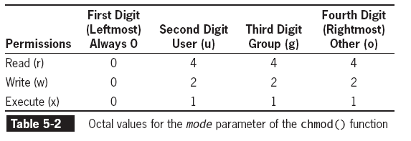
Working with File Permissions
(continued)
PHP Programming with MySQL, 2nd Edition

Slide 11
Working with File Permissions
(continued)
The chmod() function is used to change the permissions or modes of a file or directory
The syntax for the chmod() function is
chmod($filename, $mode)
Where $filename is the name of the file to change and $mode is an integer specifying the permissions for the file
PHP Programming with MySQL, 2nd Edition

Slide 12
Checking Permissions
The fileperms() function is used to read permissions associated with a file
  The fileperms() function takes one argument and returns an integer bitmap of the permissions associated with the file
  Permissions can be extracted using the arithmetic modulus operator with an octal value of 01000
The dococt() function converts a decimal value to an octal value
PHP Programming with MySQL, 2nd Edition

Slide 13
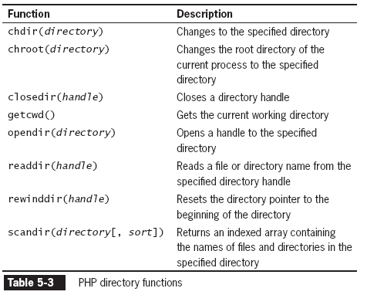
Reading Directories
The following table lists the PHP functions that read the names of files and directories
PHP Programming with MySQL, 2nd Edition

Slide 14
Reading Directories
(continued)
The opendir() function is used to iterate through entries in a directory
A handle is a special type of variable that PHP used to represent a resource such as a file or a directory
The readdir() function returns the file and directory names of an open directory
The directory pointer is a special type of variable that refers to the currently selected record in a directory listing
PHP Programming with MySQL, 2nd Edition

Slide 15
Reading Directories
(continued)
The closedir() function is used to close the directory handle
The following code lists the files in the open directory and closes the directory.
$Dir = "/var/html/uploads";
$DirOpen = opendir($Dir);
    while ($CurFile = readdir($DirOpen)) {
echo $CurFile . "<br />\n";
}
closedir($DirOpen);
PHP Programming with MySQL, 2nd Edition

Slide 16

Reading Directories
(continued)
The following Figure shows the directory listing for three files: kitten.jpg, polarbear.jpg, and gorilla.gif
Figure 5-2 Listing of the “files” subdirectory using the opendir(), readdir(), and closedir() functions
PHP Programming with MySQL, 2nd Edition

Slide 17
Reading Directories
(continued)
The PHP scripting engine returns the navigation shortcuts (“.” and “..”) when it reads a directory
The strcmp() function can be used to exclude those entries
…
while ($CurFile = readdir($DirOpen))
  if ((strcmp($CurFile, '.') != 0) &&
  (strcmp($CurFile, '..') != 0))
echo "<a href=\"files/" . $CurFile . "\">" . $CurFile . "</a><br />";
}
…
PHP Programming with MySQL, 2nd Edition

Slide 18
Reading Directories
(continued)
The scandir() function returns the names of the entries in a directory to an array sorted in ascending alphabetical order
$Dir = "/var/html/uploads";
$DirEntries = scandir($Dir);
foreach ($DirEntries as $Entry) {
echo $Entry . "<br />\n";
}
PHP Programming with MySQL, 2nd Edition

Slide 19

Reading Directories
(continued)
Figure 5-3 Listing of the “files” subdirectory
using the scandir() function
PHP Programming with MySQL, 2nd Edition

Slide 20
Creating Directories
The mkdir() function creates a new directory
To create a new directory within the current directory:
  Pass just the name of the directory you want to create to the mkdir() function
  mkdir("volunteers");
PHP Programming with MySQL, 2nd Edition

Slide 21
Creating Directories (continued)
To create a new directory in a location other than the current directory:
  Use a relative or an absolute path
    mkdir("../event");
    mkdir("/bin/PHP/utilities");
PHP Programming with MySQL, 2nd Edition

Slide 22
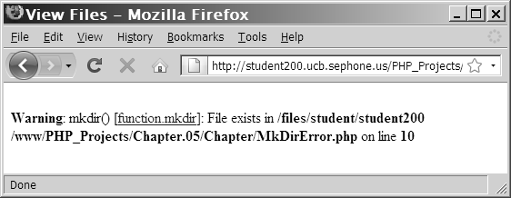
Creating Directories (continued)
  Figure 5-4 Warning that appears if a directory already exists
PHP Programming with MySQL, 2nd Edition

Slide 23
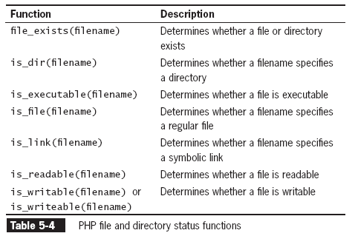
Obtaining File and Directory Information
PHP Programming with MySQL, 2nd Edition

Slide 24
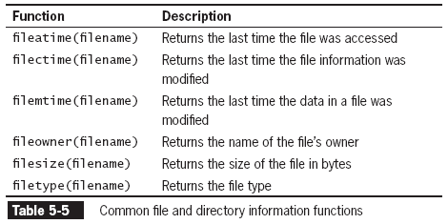
Obtaining File and Directory Information (continued)
PHP Programming with MySQL, 2nd Edition

Slide 25
Obtaining File and Directory Information (continued)
$Dir = "/var/html/uploads";
if (is_dir($Dir)) {
echo "<table border='1' width='100%'>\n";
echo "<tr><th>Filename</th><th>File Size</th>
    <th>File Type</th></tr>\n";
    $DirEntries = scandir($Dir);
foreach ($DirEntries as $Entry) {
$EntryFullName = $Dir . "/" . $Entry;
echo "<tr><td>" . htmlentities($Entry) . "</td><td>" .
filesize($EntryFullName) . "</td><td>" .
filetype($EntryFullName) . "</td></tr>\n";
}
echo "</table>\n";
}
else
echo "<p>The directory " . htmlentities($Dir) . " does not
exist.</p>";
PHP Programming with MySQL, 2nd Edition

Slide 26
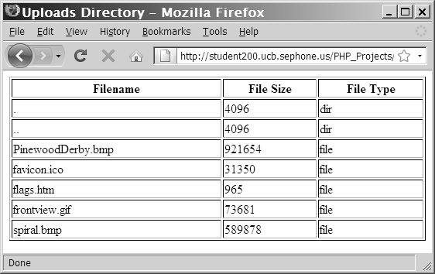
Obtaining File and Directory Information (continued)
Figure 5-5 Output of script with file and directory
information functions
PHP Programming with MySQL, 2nd Edition

Slide 27
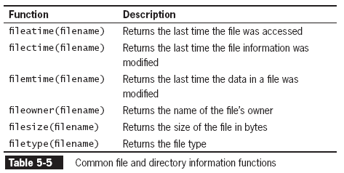
Obtaining File and Directory Information (continued)
The following table returns additional information about files and directories:
PHP Programming with MySQL, 2nd Edition

Slide 28
Uploading and Downloading Files
Web applications allow visitors to upload files to and from from their local computer (often referred to as the client)
The files that are uploaded and downloaded may be simple text files or more complex file types, such as images, documents, or spreadsheets
PHP Programming with MySQL, 2nd Edition

Slide 29
Selecting the File
Files are uploaded through an XHTML form using the “post” method
An enctype attribute in the opening form tag must have a value of “multipart/form-data,” which instructs the browser to post multiple sections – one for regular form data and one for the file contents
PHP Programming with MySQL, 2nd Edition

Slide 30
Selecting the File
(continued)
The file input field creates a Browse button for the user to navigate to the appropriate file to upload
<input type="file" name="picture_file" />
The MAX_FILE_SIZE (uppercase) attribute of a hidden form field specifies the maximum number of bytes allowed in the uploaded file
  The MAX_FILE_SIZE hidden field must appear before the file input field
PHP Programming with MySQL, 2nd Edition

Slide 31
Retrieving the File Information
When the form is posted, information for the uploaded file is stored in the $_FILES autoglobal array
The $_FILES[] array contains five elements:
  $_FILES['picture_file']['error'] // Contains the error code associated with the file
  $_FILES['picture_file']['tmp_name'] // Contains the temporary location of the file contents
PHP Programming with MySQL, 2nd Edition

Slide 32
Retrieving the File Information
(continued)
  // Contains the name of the original file
  $_FILES['picture_file']['name']
  // Contains the size of the uploaded file in bytes
  $_FILES['picture_file']['size']
  // Contains the type of the file
  $_FILES['picture_file']['type']
PHP Programming with MySQL, 2nd Edition

Slide 33
Storing the Uploaded File
  Uploaded files are either public or private depending on whether they should be immediately available or verified first
    Public files are freely available to anyone visiting the Web site
    Private files are only available to authorized visitors
PHP Programming with MySQL, 2nd Edition

Slide 34
Storing the Uploaded File (continued)
The move_uploaded_file() function moves the uploaded file from its temporary location to a permanent destination with the following syntax:
bool move_uploaded_file(string $filename, string $destination)
$filename is the contents of $_FILES['filefield']['tmp_name'] and $destination is the path and filename of the location where the file will be stored.
PHP Programming with MySQL, 2nd Edition

Slide 35
Storing the Uploaded File
(continued)
The function returns TRUE if the move succeeds, and FALSE if the move fails
if (move_uploaded_file($_FILES['picture_file']['tmp_name'], "uploads/" . $_FILES['picture_file']['name']) === FALSE)
echo "Could not move uploaded file to \"uploads/" . htmlentities($_FILES['picture_file']['name']) . "\"<br />\n";
else
echo "Successfully uploaded \"uploads/" . htmlentities($_FILES['picture_file']['name']) . "\"<br />\n";
PHP Programming with MySQL, 2nd Edition

Slide 36
Downloading Files
Files in the public XHTML directory structure can be downloaded with an XHTML hyperlink
Files outside the public XHTML directory require a three-step process:
  Tell the script which file to download
  Provide the appropriate headers
  Send the file
The header() function is used to return header information to the Web browser
PHP Programming with MySQL, 2nd Edition

Slide 37
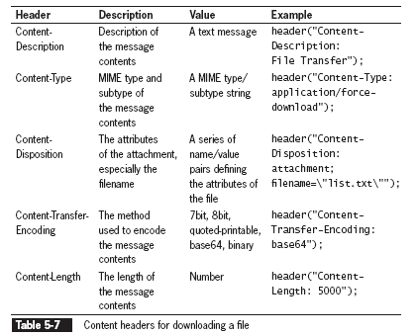
Downloading Files
(continued)
PHP Programming with MySQL, 2nd Edition

Slide 38
Writing an Entire File
PHP supports two basic functions for writing data to text files:
  file_put_contents() function writes or appends a text string to a file and returns the number of bytes written to the file
  fwrite() function incrementally writes data to a text file
PHP Programming with MySQL, 2nd Edition

Slide 39
Writing an Entire File
(continued)
The file_put_contents() function writes or appends a text string to a file
The syntax for the file_put_contents() function is:
file_put_contents (filename, string[, options])
PHP Programming with MySQL, 2nd Edition

Slide 40
Writing an Entire File
(continued)
$EventVolunteers = " Blair, Dennis\n ";
$EventVolunteers .= " Hernandez, Louis\n ";
$EventVolunteers .= " Miller, Erica\n ";
$EventVolunteers .= " Morinaga, Scott\n ";
$EventVolunteers .= " Picard, Raymond\n ";
$VolunteersFile = " volunteers.txt ";
file_put_contents($VolunteersFile, $EventVolunteers);
PHP Programming with MySQL, 2nd Edition

Slide 41
Writing an Entire File
(continued)
If no data was written to the file, the function returns a value of 0
Use the return value to determine whether data was successfully written to the file
if (file_put_contents($VolunteersFile, $EventVolunteers) > 0)
echo "<p>Data was successfully written to the
$VolunteersFile file.</p>";
else
echo "<p>No data was written to the $VolunteersFile file.</p>";
PHP Programming with MySQL, 2nd Edition

Slide 42
Writing an Entire File
(continued))
The FILE_USE_INCLUDE_PATH constant searches for the specified filename in the path that is assigned to the include_path directive in your php.ini configuration file
The FILE_APPEND constant appends data to any existing contents in the specified filename instead of overwriting it
PHP Programming with MySQL, 2nd Edition

Slide 43
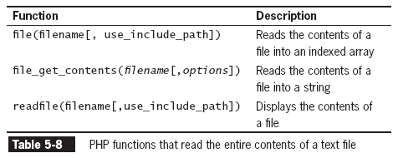
Reading an Entire File
PHP Programming with MySQL, 2nd Edition

Slide 44
Reading an Entire File
(continued)
The file_get_contents() function reads the entire contents of a file into a string
$DailyForecast = "<p><strong>San Francisco daily weather
forecast</strong>: Today: Partly cloudy. Highs from the 60s to
mid 70s. West winds 5 to 15 mph. Tonight: Increasing clouds. Lows
in the mid 40s to lower 50s. West winds 5 to 10 mph.</p>";
file_put_contents("sfweather.txt", $DailyForecast);
$SFWeather = file_get_contents("sfweather.txt");
echo $SFWeather;
PHP Programming with MySQL, 2nd Edition

Slide 45
Reading an Entire File
(continued)
The readfile() function displays the contents of a text file along with the file size to a Web browser
readfile("sfweather.txt");
PHP Programming with MySQL, 2nd Edition

Slide 46
Reading an Entire File
(continued)
The file() function reads the entire contents of a file into an indexed array
Automatically recognizes whether the lines in a text file end in \n, \r, or \r\n
  $January = " 61, 42, 48\n ";
  $January .= "62, 41, 49\n ";
  $January .= " 62, 41, 49\n ";
  $January .= " 64, 40, 51\n ";
  $January .= " 69, 44, 55\n ";
  $January .= " 69, 45, 52\n ";
  $January .= " 67, 46, 54\n ";
  file_put_contents("sfjanaverages.txt", $January);
PHP Programming with MySQL, 2nd Edition

Slide 47
Reading an Entire File
(continued)
$JanuaryTemps = file("sfjanaverages.txt");
for ($i=0; $i<count($JanuaryTemps); ++$i) {
$CurDay = explode(", ", $JanuaryTemps[$i]);
echo "<p><strong>Day " . ($i + 1) . "</strong><br />";
echo "High: {$CurDay[0]}<br />";
echo "Low: {$CurDay[1]}<br />";
echo "Mean: {$CurDay[2]}</p>";
}
PHP Programming with MySQL, 2nd Edition

Slide 48
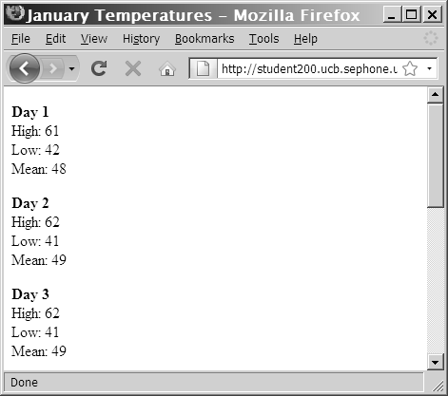
Reading an Entire File
(continued)
Figure 5-13 Output of individual lines in a text file
PHP Programming with MySQL, 2nd Edition

Slide 49
Opening and Closing File Streams
A stream is a channel used for accessing a resource that you can read from and write to
The input stream reads data from a resource (such as a file)
The output stream writes data to a resource
  1. Open the file stream with the fopen() function
  2. Write data to or read data from the file stream
  3. Close the file stream with the fclose() function
PHP Programming with MySQL, 2nd Edition

Slide 50
Opening a File Stream
A handle is a special type of variable that PHP uses to represent a resource such as a file
The fopen() function opens a handle to a file stream
The syntax for the fopen() function is:
open_file = fopen("text file", " mode");
A file pointer is a special type of variable that refers to the currently selected line or character in a file
PHP Programming with MySQL, 2nd Edition

Slide 51
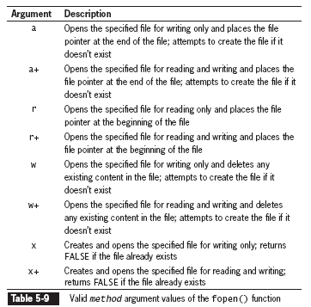
Opening a File Stream
(continued)
PHP Programming with MySQL, 2nd Edition

Slide 52
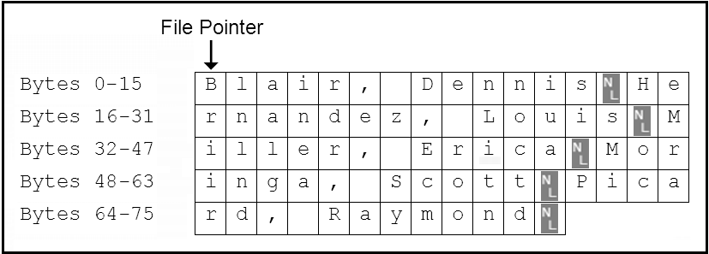
Opening a File Stream
(continued)
$VolunteersFile = fopen(“volunteers.txt", “r+");
Figure 5-15 Location of the file pointer when the fopen() function uses a mode argument of “r+”
PHP Programming with MySQL, 2nd Edition

Slide 53
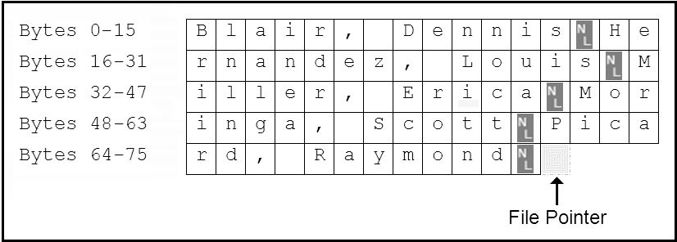
Opening a File Stream (continued)
$VolunteersFile = fopen(“volunteers.txt", “a+");
Figure 5-16 Location of the file pointer when the fopen() function uses a mode argument of “a+”
PHP Programming with MySQL, 2nd Edition

Slide 54
Closing a File Stream
Use the fclose function when finished working with a file stream to save space in memory
Use the statement fclose($handle); to ensure that the file doesn’t keep taking up space in your computer’s memory and allow other processes to read to and write from the file
PHP Programming with MySQL, 2nd Edition

Slide 55
Writing Data Incrementally
Use the fwrite() function to incrementally write data to a text file
The syntax for the fwrite() function is:
fwrite($handle, data[, length]);
The fwrite() function returns the number of bytes that were written to the file
If no data was written to the file, the function returns a value of 0
PHP Programming with MySQL, 2nd Edition

Slide 56
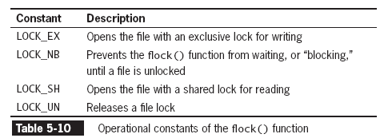
Locking Files
To prevent multiple users from modifying a file simultaneously use the flock() function
The syntax for the flock() function is:
flock($handle, operation)
PHP Programming with MySQL, 2nd Edition

Slide 57
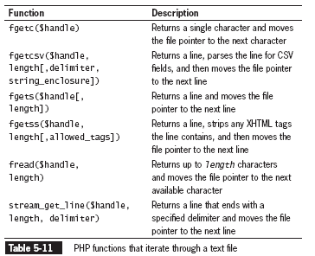
Reading Data Incrementally
The fgets() function uses the file pointer to iterate through a text file
PHP Programming with MySQL, 2nd Edition

Slide 58
Reading Data Incrementally (continued)
You must use fopen() and fclose() with the functions listed in Table 5-10
Each time you call any of the functions in Table 5-10, the file pointer automatically moves to the next line in the text file (except for fgetc())
Each time you call the fgetc() function, the file pointer moves to the next character in the file
PHP Programming with MySQL, 2nd Edition

Slide 59
Managing Files and Directories
PHP can be used to manage files and the directories that store them
Among the file directory and management tasks for files and directories are
  Copying
  Moving
  Renaming
  Deleting
PHP Programming with MySQL, 2nd Edition

Slide 60
Copying and Moving Files
Use the copy() function to copy a file with PHP
The function returns a value of TRUE if it is successful or FALSE if it is not
The syntax for the copy() function is:
  copy(source, destination)
For the source and destination arguments:
  Include just the name of a file to make a copy in the current directory, or
  Specify the entire path for each argument
PHP Programming with MySQL, 2nd Edition

Slide 61
Copying and Moving Files (continued)
if (file_exists(" sfweather.txt ")) {
if(is_dir(" history ")) {
if (copy(" sfweather.txt ",
" history\\sfweather01-27-2006.txt "))
echo " <p>File copied successfully.</p> ";
else
echo " <p>Unable to copy the file!</p> ";
}
else
echo (" <p>The directory does not exist!</p> ");
}
else
echo (" <p>The file does not exist!</p> ");
PHP Programming with MySQL, 2nd Edition

Slide 62
Renaming Files and Directories
Use the rename() function to rename a file or directory with PHP
The rename() function returns a value of true if it is successful or false if it is not
The syntax for the rename() function is: rename(old_name, new_name)
PHP Programming with MySQL, 2nd Edition

Slide 63
Removing Files and Directories
Use the unlink() function to delete files and the rmdir() function to delete directories
Pass the name of a file to the unlink() function and the name of a directory to the rmdir() function
Both functions return a value of true if successful or false if not
Use the file_exists() function to determine whether a file or directory name exists before you attempt to delete it
PHP Programming with MySQL, 2nd Edition

Slide 64
Summary
In PHP, a file can be one of two types: binary or text
A binary file is a series of characters or bytes for which PHP attaches no special meaning
A text file has only printable characters and a small set of control of formatting characters
A text file translates the end-of-line character sequences in code display
The UNIX/Linux platforms end a line with the \n sequence
PHP Programming with MySQL, 2nd Edition

Slide 65
Summary (continued)
The Windows platforms end a line with the \n\r sequence
The Macintosh platforms end a line with the \r sequence
Files and directories have three levels of access: user, group, and other
Typical file and directory permissions include read, write, and execute
PHP provides the chmod() function for changing the permissions of a file within PHP
PHP Programming with MySQL, 2nd Edition

Slide 66
Summary (continued)
The syntax for the chmod()function is chmod($filename, $mode)
The chmod() function uses a four-digit octal value to assign permissions
The fileperms(), which takes filename as the only parameter, returns a bitmap of the permissions associated with a file
The opendir() function iterates through the entries in a directory
PHP Programming with MySQL, 2nd Edition

Slide 67
Summary (continued)
A handle is a special type of variable that represents a resource, such as a file or directory
To iterate through the entries in a directory, you open a handle to the directory with the opendir() function
Use the readdir() function to return the file and directory names from the open directory
Use the closedir() function to close a directory handle
PHP Programming with MySQL, 2nd Edition

Slide 68
Summary (continued)
The scandir() function returns an indexed array of the files and directories ( in ascending alphabetical order) in a specified directory
The mkdir(), with a single name argument, creates a new directory
The is_readable(), is_writeable(), and is_executable() functions check the the file or directory to determine if the PHP scripting engine has read, write, or execute permissions, respectively
PHP Programming with MySQL, 2nd Edition

Slide 69
Summary (continued)
A symbolic link, which is identified with the is_link() is a reference to a file not on the system
The is_dir() determines if a directory exists
Directory information functions provide file access dates, file owner, and file type
Uploading a file refers to transferring the file to a Web server
PHP Programming with MySQL, 2nd Edition

Slide 70
Summary (continued)
Setting the enctype attribute of the opening from tag to multipart/form-data instructs the browser to post one section for regular form data and one section for file contents
The file input type creates a browse button that allows the user to navigate to a file to upload
To limit the size of the file upload, above the file input field, insert a hidden field with an attribute MAX_FILE_SIZE and a value in bytes
PHP Programming with MySQL, 2nd Edition

Slide 71
Summary (continued)
An uploaded file’s information (error code, temporary file name, filename, size, and type) is stored in the $_FILES array
MIME (Multipurpose Internet Mail Extension) generally classifies the file upload as in “image.gif”, “image.jpg”, “text/plain,” or “text/html”
The move_uploaded_file() function moves the uploaded file to its permanent destination
PHP Programming with MySQL, 2nd Edition

Slide 72
Summary (continued)
The file_put_contents() function writes or appends a text string to a file and returns the number of bytes written to the file
The FILE_APPEND constant appends data to any existing contents in the specified filename instead of overwriting it
The file_get_contents() and readfile() functions read the entire contents of a file into a string
PHP Programming with MySQL, 2nd Edition

Slide 73
Summary (continued)
A stream is a channel that is used for accessing a resource to which you may read, and write.
The input stream reads data from a resource, such as a file
The output stream writes data to a resource, such as a file
The fopen() opens a handle to a file stream using the syntax $open_file = fopen("text file", "mode");
PHP Programming with MySQL, 2nd Edition

Slide 74
Summary (continued)
A file pointer is a variable that refers to the currently selected line or character in a file
Mode arguments used with the fopen() function specifies if the file is opened for reading, writing, or executing, and the indicates the location of the file pointer
The fclose() function with a syntax of fclose($handle); is used to close a file stream
PHP Programming with MySQL, 2nd Edition

Slide 75
Summary (continued)
The fwrite() incrementally writes data to a text file
To prevent multiple users from modifying a file simultaneously use the flock() function
A number of PHP functions are available to iterate through a text file by line or character
Use the copy() function to copy a file with PHP
Use the rename() function to rename a file or directory with PHP
PHP Programming with MySQL, 2nd Edition

Slide 76
Summary (continued)
The unlink() function is used to delete files and the rmdir() function is used to delete directories
In lieu of a move function, the rename() function renames a file and specifies a new directory to store the renamed file
PHP Programming with MySQL, 2nd Edition

